Slide 1
CPE 133: Digital Design
Administrative
Syllabus Highlights
Questions
Course Overview
Number Systems

Slide 2
CPE 133 Spring 2018 Grades (two sections)
Grade | Spring 2018
A | 3
A- | 2
B+ | 6
B | 7
B- | 2
C+ | 2
C | 16
C- | 3
D | 3
F | 5
GPA | ~2.3

Slide 3
A Question
Prepare to ask a question
Write it down
I’ll collect it and answer it

Slide 4
Important Stuff
My main requirement is that you learn the material by week 12 (finals week)
My student & teaching experience
“Respect” policy
“Cheating” policy
My Quirks
Bad hearing
Treat each other with respect
Don’t come to class if you’re sick

Slide 5
The Biggest Problems
Looking for that formula to plug into in order to complete the assignment
CPE 133 is a design course
Not one correct solution to problems
Cal Poly is harder than HS & CC
Putting off learning the course material
You won’t be able to “wing it”
Not asking lots of questions
It’s how the course works

Slide 6
Digital Design
What is it?
Designing digital circuits to solve problems
Modern digital design
PC Board design
IC Design
PLD Design

Slide 7
How does CPE 133 Fit it?
Digital courses
CPE 133
Basic digital design
CPE 233
Computer design, assembly language programming
CPE 329 or CPE 336 or CPE 316 or CPE 333
Basic embedded systems design (MCUs)
Various Technical Electives
Lots of new cool courses

Slide 8
Questions:
Ask a question

Slide 9
Digital Design Foundation Modeling (DDFM)
Digital Design: using digital circuits to solve problems
Digital Circuit: a set of modules that exchange information under the control of “something”
Structured Design: any digital circuit can be built using a set of “foundation modules”
Foundation Modules:
Simple to understand at a high-level
Categorized as either a “controlled” or “controller” circuit
Four Ways to Control a Circuit: 1) none, 2) internal, 3) external, and 4) circuit
Three Design Approaches: 1) Brute Force (BFD), 2) Iterative Modular (IMD), 3) Modular (MD)

Slide 10
The Big Digital Design Picture

Slide 11
Digital Design
Analog vs. Digital
Examples:
Stairs vs. Ramp
CF vs. Incandescent
Guitar vs. Violin
Continuous vs. Discrete

Slide 12
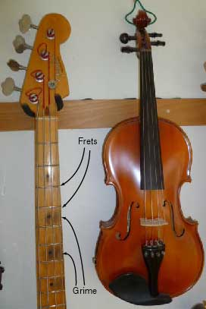
Frets vs No Frets

Slide 13
Modern Digital Design
Two main qualities:
Modular
Hierarchical
Based on Models
What’s a model?

Slide 14
Models: What are they?
Definition 1: A description of something
Definition 2: A description of something in terms that highlights the relevant information while hiding the less useful information
Purpose: transfers information to the entity reading the model
Comments:
Hierarchical definition?
No absolutely “correct” model

Slide 15
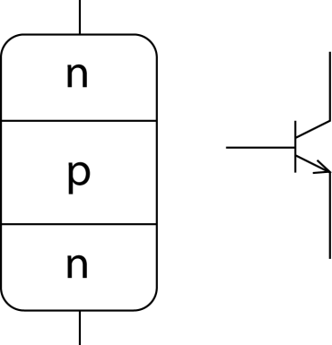
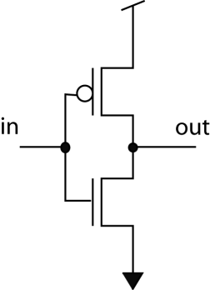
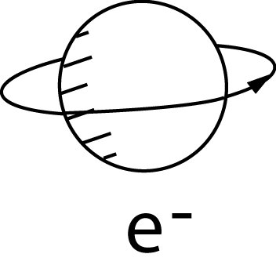
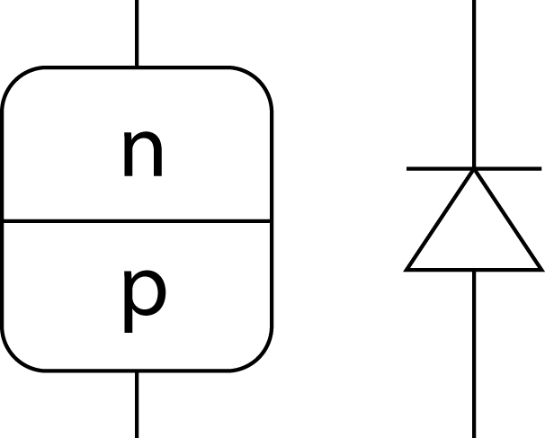
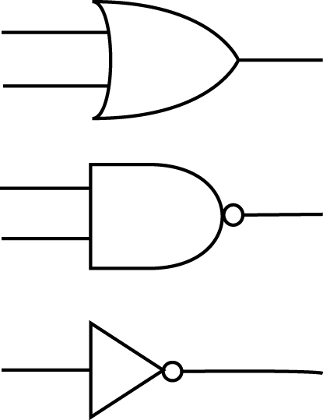
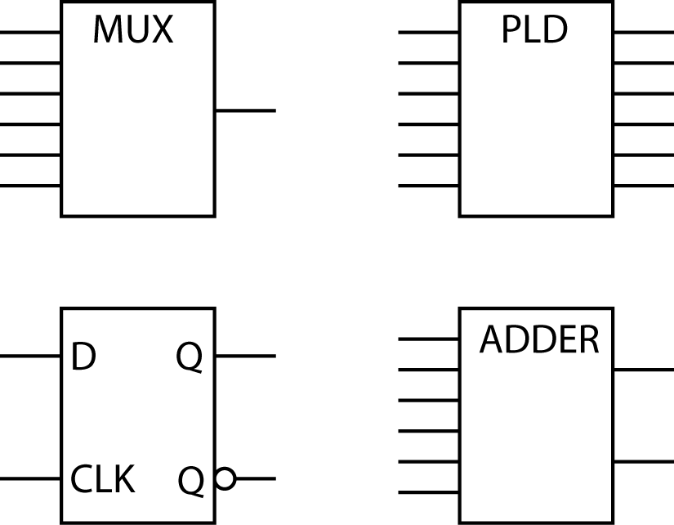
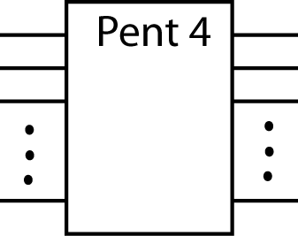
Digital Device Hierarchy

Slide 16
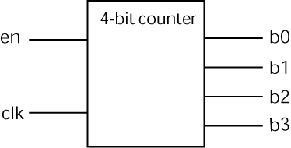
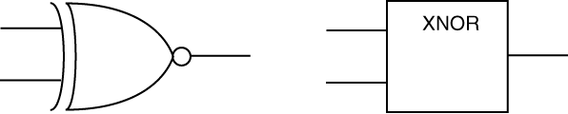
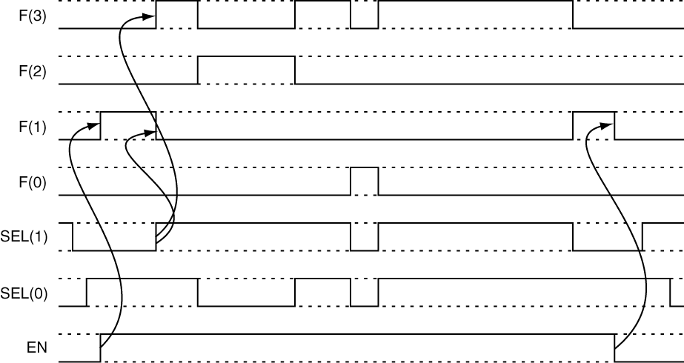
Digital Design Model Types
entity dff is
port (D,S,R : in std_logic;
CLK : in std_logic;
Q, nQ : out std_logic);
end dff;
architecture dff of dff is
begin
process(D,S,R,CLK)
begin
if (R = '0') then
Q <= '0'; nQ <= '1';
elsif (S = '0') then
Q <= '1'; nQ <= '0';
elsif (rising_edge(CLK)) then
Q <= D;
nQ <= not D;
end if;
end process;
end dff;
Black box model
Digital Circuit Elements
VHDL Model
The circuit has four inputs and two outputs. The outputs are always complements of each other. Two inputs, R and S, are asynchronous negative logic inputs. When R is asserted (negative logic), the Q output is ‘0’; when S is asserted, the output is ‘1’. The R input takes precedence over the S input. The Q output follows the D output on the active clock edge (rising-edge triggered).
Timing Diagram
Written Description

Slide 17
Mealy’s Laws of Digital Design
First Law:
If in doubt, draw a bunch of boxes…
Second Law:
If your design runs into weird obstacles that require kludgy solutions, toss out the design and start over

Slide 18
Numbers
Caveman example
CPE 133 Number Systems
Stoneage Unary (for humans)
Decimal (for humans)
Binary (for computers)
Hexadecimal (humans with computers)

Slide 19
Number Definitions
You all know this…
Number System: a language system consisting of an ordered set of symbols (called digits) with rules defined for various mathematical operations.
Radix: the number of symbols in the ordered set of symbols used in a number system.
Number: a collection of digits; a number can contain both a fractional and integral part.
Radix Point: a symbol used to delineate the fractional and integral portions of a number.

Slide 20
Numbers
NUMBER =
(N)R = (A_{n-1} A_{n-2} … A₁ A₀ . A₋₁ A₋₂ … A_{–m}) _{R}
where:
R ≡ Radix
A ≡ a digit in the number
A _{n-1} ≡ the most significant digit (MSD)
A _{-m} ≡ the least significant digit (LSD)

Slide 21
Juxtapositional Notation
Placing numbers side by side
Each digit position has a “weight” associated with it
Weights are powers of the radix
Examples
987.45
101.11₂
(binary to decimal conversion)

Slide 22
Decimal & Binary & Hexadecimal
Decimal ordered symbols (base 10)
(0,1,2,3,4,5,6,7,8,9)
Binary ordered symbols (base 2)
(0,1)
Hexadecimal or Hex (base 16)
(0,1,2,3,4,5,6,7,8,9,A,B,C,D,E,F)

Slide 23
Decimal & Binary & Hex
(Draw on board)

Slide 24
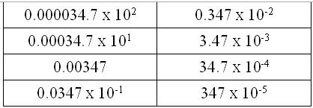
Engineering Notation
Massively important
Fast approach to transferring quantities
Based on intuition rather than brain power
Subset of Scientific Notation
Uses number multiplied by exponential power of 10
Example 34.2 x 10⁵
The Problem:
All equivalent values!

Slide 25
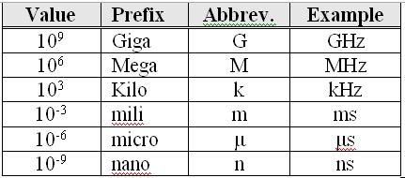
Engineering Notation
Two parts to numbers
Magnitude
Exponential part
Magnitude:
Must be: [1,1000)
Exponent:
Must multiple of 3
Must use appropriate prefix

Slide 26
Examples
Convert the following two values to engineering notation
452300 Hz
84.3 x 10⁻⁸ s

Slide 27
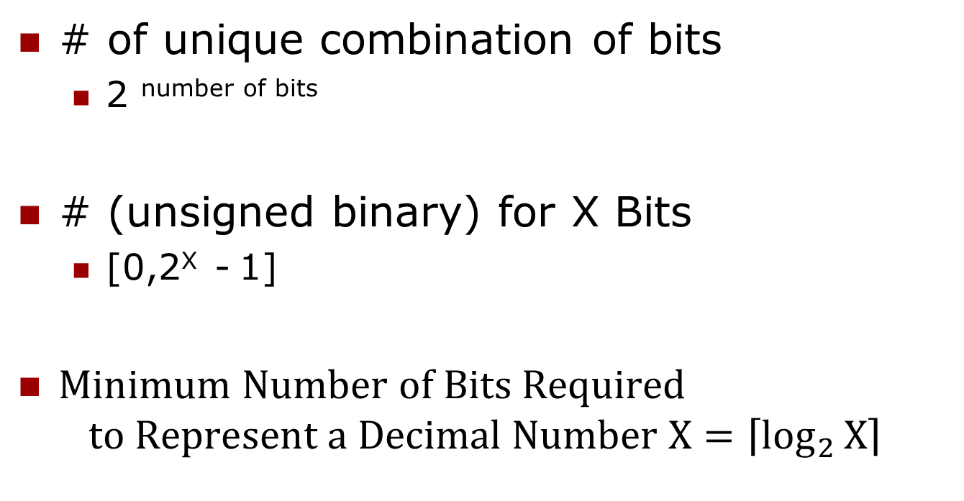
Important Binary Attributes
# of unique combination of bits
2 ^{number of bits}
# (unsigned binary) for X Bits
[0,2^{X} - 1]
$Minimum Number of Bits Required$
$$to Represent a Decimal Number X=\left\lceil \log_{2}{X}\right\rceil$$

